Slide 1
Prototypes
Project Idea Presentation
CCU 2020

Slide 2
Team
Project Manager
User-research Lead
Design Lead
Front-end Developer
Back-end Developer
Documentation Lead
Francisco Mira (180888)
Francisco Cecílio (189444)
Isabel Soares (189466)
Lídia Custódio (189492)
Ricardo Machado (179751)
Filipe Amaral (424759)

Slide 3
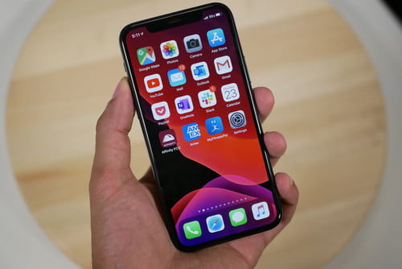
Project Idea
Recomendation system
Avoid crowds
Create a path that goes through the places you want to go
Applied in enclosured spaces: zoos, shopping malls, museums, amusement parks…

Slide 4
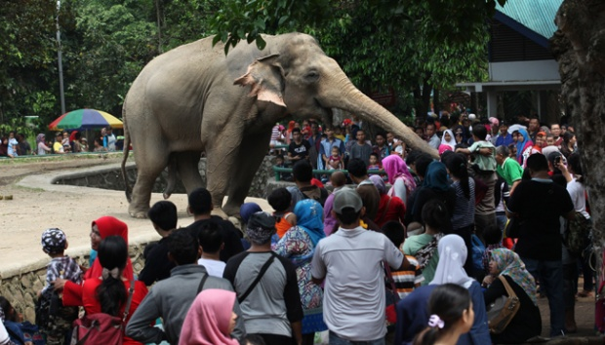
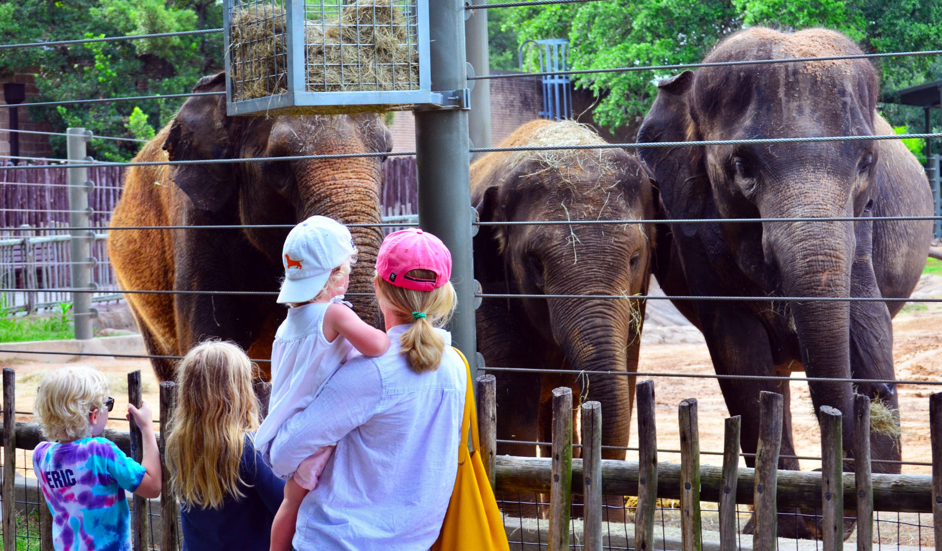

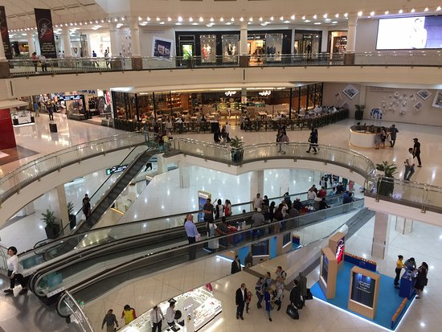

Slide 5
SQVID

Slide 6
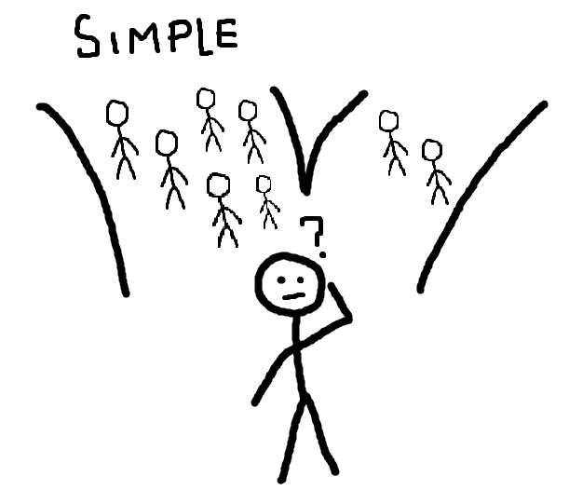
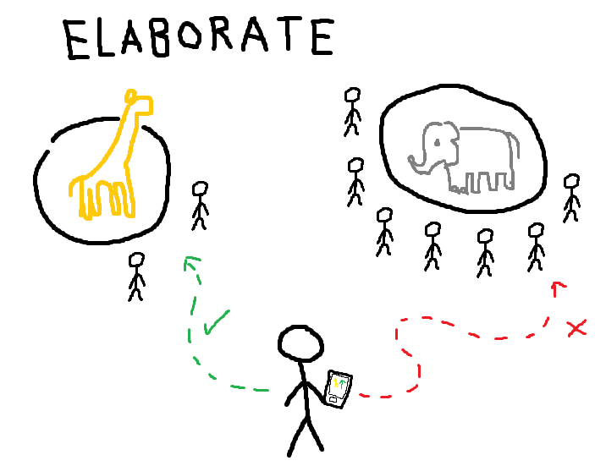

Slide 7
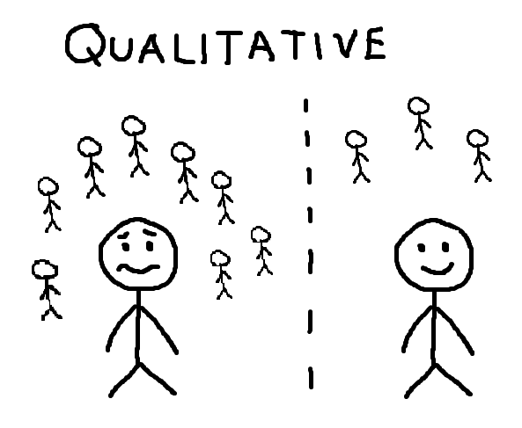
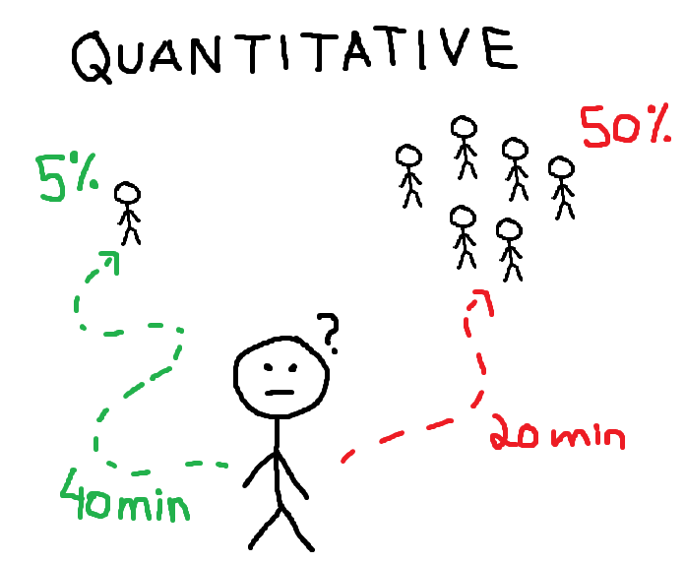

Slide 8
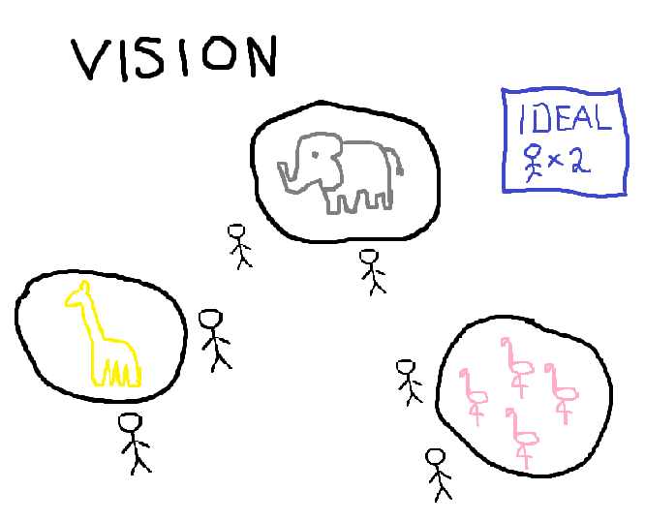
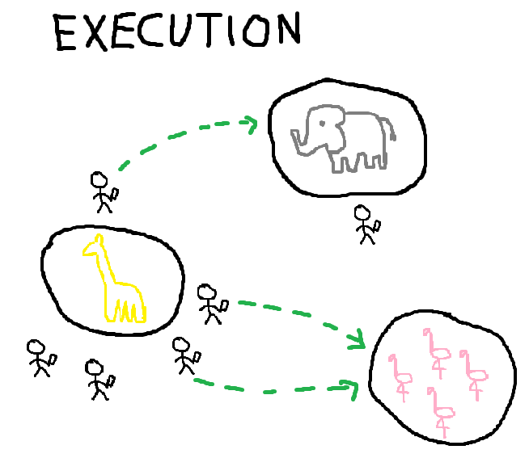

Slide 9

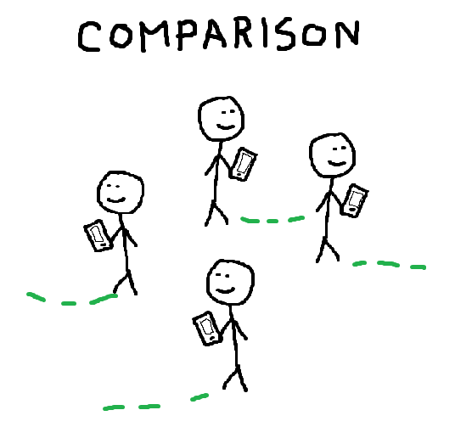

Slide 10
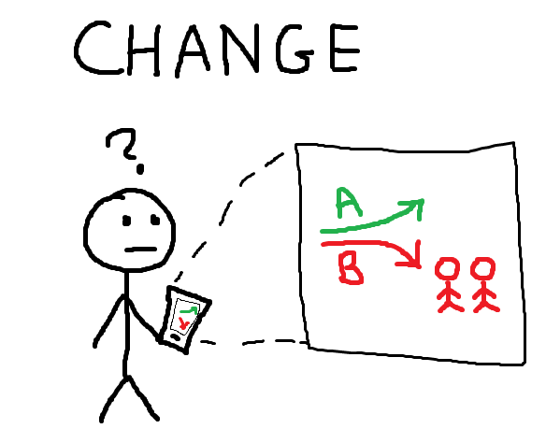
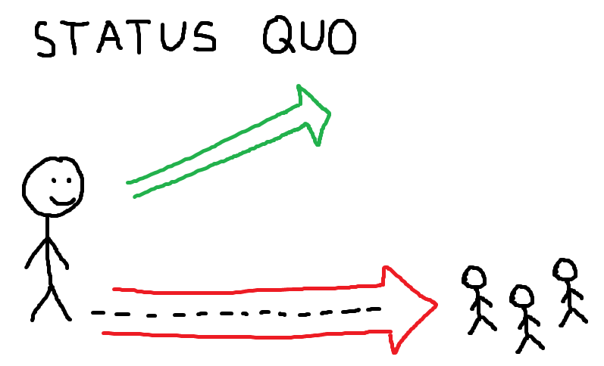

Slide 11
Questions?

